Slide 1
Amazon Web Services
and Simple Workflow Service
Arkansas Venture Center
Tuesday, April 28th, 2015
Presenter: Nick Meshes (nmeshe@gmail.com)

Slide 2
Agenda
What is Amazon Web Services?
Terminology & related technologies of AWS
Simple Workflow Service overview
Code examples of integrating with SWF
Use Cases of SWF
Q&A, Comments, Takeaways

Slide 3
But first…
Nick does not work for Amazon
Nick has a bias on this topic
Nick has great admiration for Amazon
Nick has great admiration for you

Slide 4
What’s this AWS?
Amazon Web Services
Security (Identity and Access Management)
IaaS / PaaS to support your SaaS
Self-service
Easy and quick setup /management
Scalability
Availability
Pay for what you use
Who uses AWS?
Netflix
Expedia
Reddit
Pinterest
Airbnb
NASA
smart people in this room

Slide 5
Service Categories
Computing
Storage
Database
Networking
Administration
Security
Deployment & Management
Application Container
Analytics
Application Services (including SWF)
Enterprise Applications

Slide 6
AWS Terminology
Identity & Access Management (IAM)
Virtual Private Cloud (VPC)
Amazon Machine Image (AMI)
Elastic Block Storage (EBS)
Elastic Compute Cloud (EC2)
Simple Storage Service (S3)
Reduced Redundancy Storage (RRS)
Relational Database Storage (RDS)
Simple Notification Service (SNS)
CloudWatch
Elastic Map Reduce (EMR)
Data Pipeline
Simple Workflow (SWF)
and on and on and on…

Slide 7
Identity & Access Management (IAM)
Securely control access to AWS services and resources
Create and manage AWS users and groups
Allow and deny their access to AWS resources
Multi-Factor Authentication (MFA)
Fine-grained control
specific APIs or resources
time of day
originating IP address
using SSL
Integrate with existing identity systems
Active Directory
SAML 2.0
AWS Console SSO
API federation

Slide 8
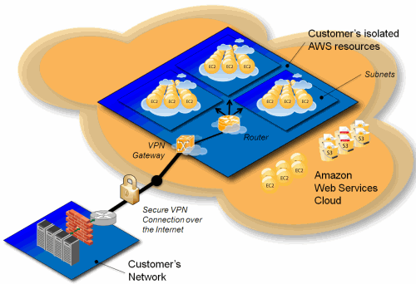
Amazon VPC (Virtual Private Cloud)
Launch AWS resources in your defined virtual network
Why use VPC?
Cloud extension of IT infrastructure
Secure
Simple
Flexible
Scalable Reliable
Because you have to
Image: aws.amazon.com

Slide 9
Amazon EC2 (Elastic Compute Cloud)
Computing resources on demand
Bootable and configurable virtual machines
AMI (Amazon Machine Image)
Why EC2?
Automatically obtain servers when necessary
Backup & Disaster recovery
Build scalable applications with other AWS services
S3
RDS
Elastic Beanstalk
EMR
etc…

Slide 10
Amazon S3 (Simple Storage Service)
Data storage & management
Buckets and objects
Upload/download
Serve content
Static & dynamic websites
Apps
archives
Capabilities
Availability zones
Access control & encryption
Versioning
Redundancy
Archive
Life cycle

Slide 11
Amazon S3 low cost options
RRS (Reduced Redundancy Storage)
Storage with less redundancy
Can be used for non-critical data
Low cost
Amazon Glacier
Archive
For non-frequently accessed data
Low cost

Slide 12
Amazon RDS (Relational Database Service)
Supports MySQL, Oracle, Microsoft SQL Server, PostgreSQL, or Amazon Aurora
Monitoring with Amazon CloudWatch & SNS
(Simple Notification Service)
Paid on DB instance hours, storage & data transfer

Slide 13
Amazon DynamoDB (NoSQL Database Service)
Comparable to major NoSQL databases (Cassandra, MongoDB, Redis, CouchDB…)
Supports both document and key-value data models
Object Persistence Framework
Paid on DB instance hours, storage & data transfer

Slide 14
Amazon EMR (Elastic MapReduce)
What?
Hadoop implementation on top of Amazon EC2
Integration with other AWS data stores like S3 and DynamoDB
Integration with Spark (faster EMR) and Presto (distributed SQL engine)
Why use EMR?
EMR sets up and manages Hadoop clusters for you
Scalable, Secure, Reliable
Pay for what you use
SQL-like languages supported: Pig, Hive,…

Slide 15
Amazon Data Pipeline
Data-driven process
Transfer data between AWS
Pipeline / workflow
Data sources
Schedules
Preconditions
Activities

Slide 16
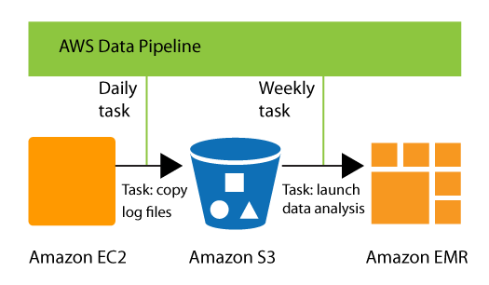
Diagram: AWS Data Pipeline
Image: docs.aws.amazon.com

Slide 17
SWF (Amazon Simple Workflow Service)
Process orchestration tool for building scalable, asynchronous, concurrent, and distributed applications
Parallel or sequential steps
State tracker and task coordinator
Monitoring of Status & Progress
You can access SWF in many ways:
AWS SDKs for Java, Ruby, .NET, and PHP
AWS Flow Framework for Java or Ruby
Amazon SWF web service APIs, which can be accessed through other languages (e.g. using boto for Python)
AWS Management Console
AWS Command Line Interface

Slide 18
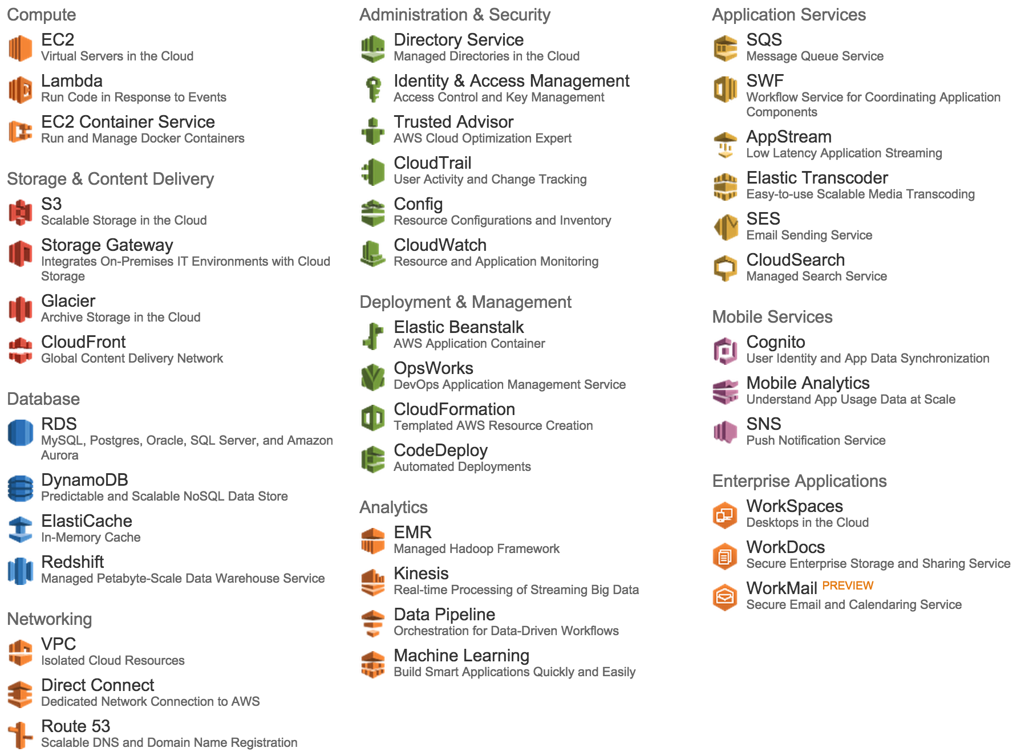
And a LOT of other services

Slide 19
Simple Workflow Service
“A lot better than cronjob”
Many use cases for “batch processing”
media processing
order/payments processing
web application back-ends
distributed ETL systems
analytics pipelines (not Data Pipeline)
infrastructure automation
other business process workflows
Invoked by and invokes various processing steps
executable code
web service calls
human actions
scripts

Slide 20
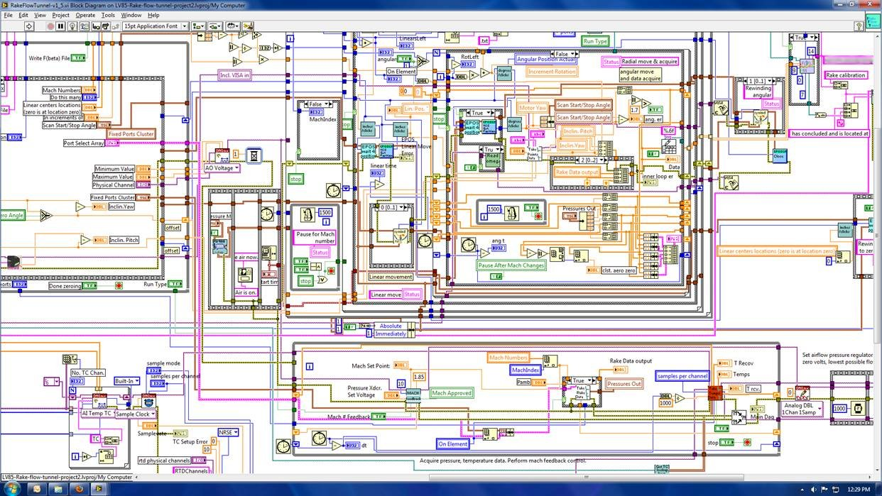
Straining the spaghetti
Image: thedailywtf.com
Image: matthewturland.com

Slide 21
Developers focus on business logic,
not glue code and state management
Simple Workflow service provides a simple interface
workflow orchestration
reliable task dispatch
state management
SWF manages the execution flow
tasks are load balanced across registered workers
inter-task dependencies are respected
concurrency is handled appropriately
child workflows are executed
Engineers focus on developing ‘workers’ to perform the actual tasks in a workflow instead of worrying about orchestration and scheduling of those tasks.

Slide 22
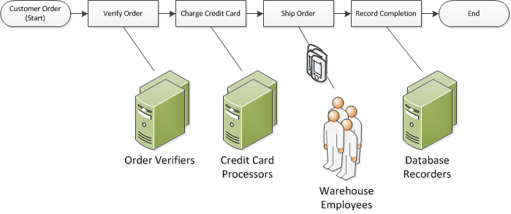
SWF Workflow Concepts
Workflow - a set of activities that carry out some objective, together with logic that coordinates the activities.
Each workflow runs in an AWS resource called a domain, which controls the workflow's scope.
An AWS account can have many domains
A domain can have many workflows
workflows in different domains cannot interact
Image: docs.aws.amazon.com

Slide 23
SWF Workflow Concepts
Define each of the required activities in the workflow
Register each activity with Amazon SWF as an activity type
provide name and version
provide timeout values based on how long you expect the activity to take
Some activities may need to be performed more than once, perhaps with varying inputs.
Each run is represented by a separate activity.
Activity Worker - a program that receives activity tasks, performs them, and provides results
Activities may be performed by people
Activity tasks and activity workers can run synchronously or asynchronously
distributed across multiple computers or run on the same computer
be in different geographic regions
written in different programming languages
run on different operating systems
Run on Amazon EC2, your own premises, or other provider

Slide 24
SWF Workflow Concepts
Decider - the coordination logic in a workflow
schedules activity tasks
provides input data to the activity workers
processes events that arrive while the workflow is running
ends (or closes) the workflow when the objective has been completed
Decider interacts with SWF service
receiving decision tasks from Amazon SWF
responding back to Amazon SWF with decisions
A decision is an action or set of actions which are the next steps in the workflow.
Typically, schedule an activity task.
Decisions can also:
set timers to delay the execution of an activity task
request cancellation of activity tasks already in progress
complete or close the workflow

Slide 25
SWF Workflow Concepts
The Amazon SWF service is the reliable central hub
centralized orchestration and workflow state persistence service
data exchange between the decider, activity workers, and other relevant entities, such a human administrator
tracks worker progress
provides details on completion/status
maintains each worker’s state and application's execution state durably
The activity workers and the decider receive their tasks by polling the Amazon SWF service
Amazon SWF includes a copy of the current workflow execution history with each decision task sent to the decider
The workflow execution history is composed of events
an event represents a significant change in the state of the workflow execution.
Examples of events include:
the completion of a task
notification that a task has timed out
the expiration of a timer that was set earlier in the workflow execution

Slide 26
SWF Workflow Concepts
Workflow Executor / Workflow Starter
any application or entity that can initiate workflow executions
frequently initiated by a user action or a cronjob
Example: the website or mobile app where a customer places an order
A user must have authorized AWS access keys to run workflows in your account
access keys provide full access to all of the resources, difficult to revoke,
not appropriate for all applications
Amazon SWF access control uses AWS Identity and Access Management (IAM), which allows you to provide access to AWS resources in a controlled way that does not expose your access keys.
For example, you can allow a user to access your account, but only to run certain workflows in a particular domain.
Implement, deploy, scale, and modify components independently
Application is resilient to failures in individual components

Slide 27
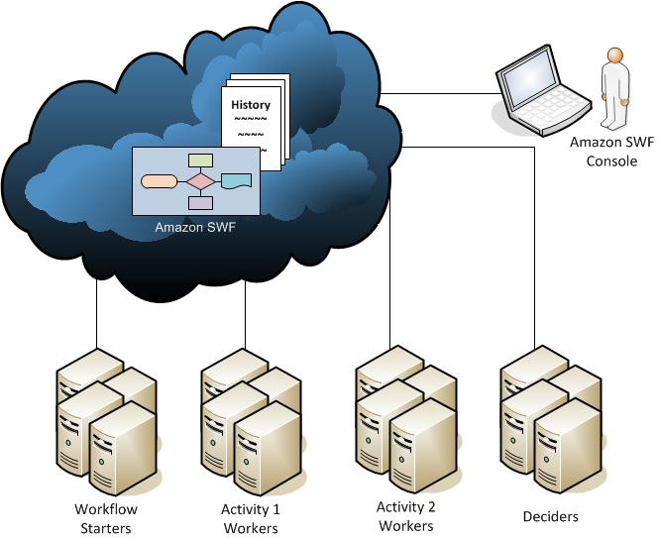
Image: docs.aws.amazon.com

Slide 28
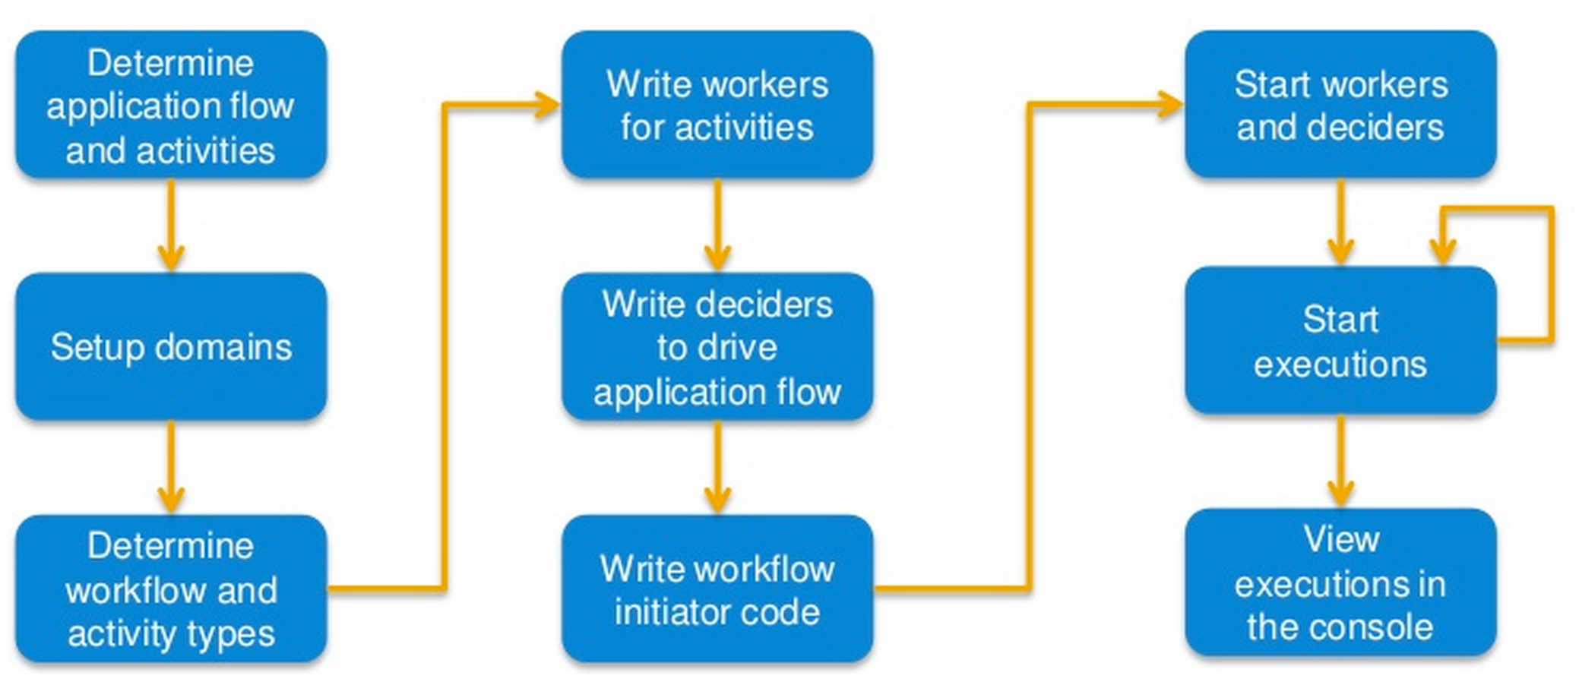
Process to create a SWF application
Source: “Introducing Amazon Simple Workflow (Amazon SWF)”
by Balan Subramanian, Sr. Product Manager for Amazon SWF

Slide 29
Register Domain
$swf = new AmazonSWF();
$domainName = 'ImageProcessor';
$retention_period_in_days = 5;
$domainOpts = array(
'description' => 'This domain will be used for image processing',
'name' => $domainName,
'workflowExecutionRetentionPeriodInDays' => (string) $retention_period_in_days
);
$response = $swf->registerDomain($domainOpts);
if ($response->isOK()) {
echo 'Domain ' . json_encode($domainOpts) . " registered\n";
} else {
// A real application may want to handle errors during domain registration,
// but if the domain already exists, it's safe to ignore that error.
print_r($response->body);
}

Slide 30
Register Workflow in Domain
$swf = new AmazonSWF();
$domainName = 'ImageProcessor';
$swf->registerDomain($domainOpts); //see above
$workflowOpts = array(
'domain' => $domainName,
'name' => "myWorkflowName",
'version' => "myWorkflowVersion",
'description' => 'Periodically runs stuff'
);
$response = $swf->registerWorkflowType($workflowOpts);
if ($response->isOK()) {
echo 'Workflow ' . json_encode($workflowOpts) . " registered\n";
} else {
// A real application may want to handle errors during type registration,
// but if the type already exists, it's safe to ignore that error.
print_r($response->body);
}

Slide 31
Start Decider Worker
$swf = new AmazonSWF();
$domainName = 'ImageProcessor';
$decider_task_list = 'deciderTaskList';
$swf->registerDomain($domainOpts); //see domain registration above
$workflow_decider = new ImageProcessorDecider($swf,
$domainName, $decider_task_list);
$workflow_decider->start();
/**
* The ImageProcessorDecider inspects the history of the
* workflow and then schedules more tasks based
* on the current state of the workflow
* using $swf->poll_for_decision_task()
*/

Slide 32
Decider Worker Logic
public function start() {
while (true) {
$opts = array(
'domain' => $this->domain,
'taskList' => array(
'name' => $this->task_list
)
);
$response = $this->swf->poll_for_decision_task($opts);
//checking response for errors and handling goes here
$task_token = (string) $response->body->taskToken;
//more error handling goes here
$history = $response->body->events();
$decision_list = self::_decide(new HistoryEventIterator(
$this->swf, $opts, $response ));
// _decide() is the fancy logic to assess the current state and
// return with the correct activity or event to do next
$complete_opt = array(
'taskToken' => $task_token,
'decisions'=> $decision_list
);
$complete_response = $this->swf->respond_decision_task_completed($complete_opt);
if ($complete_response->isOK()) {
echo "RespondDecisionTaskCompleted SUCCESS\n";
} else {
// a real application may want to report this failure and retry
echo "RespondDecisionTaskCompleted FAIL\n";
echo "Response body: \n";
print_r($complete_response->body);
echo "Request JSON: \n";
echo json_encode($complete_opt) . "\n";
}
}
}

Slide 33
Example Decision JSON
{
"decisionType" : "ScheduleActivityTask",
"scheduleActivityTaskDecisionAttributes" : {
"activityType" : {
"name" : "myActivityName",
"version" : "myActivityVersion"
},
"activityId" : "verification-27",
"control" : "digital music",
"input" : "5634-0056-4367-0923,12/12,437",
"scheduleToCloseTimeout" : "900",
"taskList" : {
"name": "deciderTaskList"
},
"scheduleToStartTimeout" : "300",
"startToCloseTimeout" : "600",
"heartbeatTimeout" : "120"
}
}

Slide 34
Register Activity Workers
$swf = new AmazonSWF();
$domainName = ‘ImageProcessor';
$activity_task_list = 'activityTaskList';
$swf->registerDomain($domainOpts); //see domain registration above
$activityOpts = array(
'domain' => $domainName,
'name' => "myActivityName",
'version' => "myActivityVersion",
'description' => 'Does some work'
);
$response = $swf->registerActivityType($activityOpts);
if ($response->isOK()) {
echo 'Activity ' . json_encode($activityOpts) . " registered\n";
} else {
// A real application may want to handle errors during type registration,
// but if the type already exists, it's safe to ignore that error.
print_r($response->body);
}
$activity_worker = new ImageProcessorActivityWorker($swf, $domainName, $activity_task_list);
echo "Starting activity worker polling\n";
$activity_worker->start();

Slide 35
Activity Worker Logic
public function start() {
while (true) {
$response = $this->swf->poll_for_activity_task(array(
'domain' => $this->domain,
'taskList' => array( 'name' => $this->task_list ) ));
//checking response for errors and handling goes here
$task_token = (string) $response->body->taskToken;
//more error handling goes here
$activity_input = (string) $response->body->input;
$activity_output = doSomethingUseful($activity_input);
//actual work logic goes into doSomethingUseful()
$complete_opt = array( 'taskToken' => $task_token,
'result' => $activity_output );
$complete_response = $this->swf->respond_activity_task_completed($complete_opt);
if ($complete_response->isOK()) {
echo "RespondActivityTaskCompleted SUCCESS\n";
} else {
// a real application may want to report this failure and retry
echo "RespondActivityTaskCompleted FAIL\n";
echo "Response body:\n";
print_r($complete_response->body);
echo "Request JSON:\n";
echo json_encode($complete_opt) . "\n";
}
}
}

Slide 36
Start Execution
$swf = new AmazonSWF();
$domainName = ‘ImageProcessor';
$decider_task_list = 'deciderTaskList';
$swf->registerDomain($domainOpts); //see domain registration above
$response = $swf->registerWorkflowType($workflowOpts); //see workflow registration above
$workflow_input = json_encode(array(
'activityName' => “myActivityName",
'activityVersion' => "myActivityVersion",
'activityTaskList' => 'activityTaskList',
'activityInput' => 'World',
'timerDuration' => '5'
));

Slide 37
Start Execution (continued)
$executionOpts = array(
'domain' => $domainName,
'workflowId' => 'myWorkflowId-' . time(),
'workflowType' => array( 'name' => “myWorkflowName", 'version' => “myWorkflowVersion" ),
'input' => $workflow_input,
'childPolicy' => 'TERMINATE',
// This is what specifying a task list at scheduling time looks like.
// You can also register a type with a default task list
// and not specify one at scheduling time.
'taskList' => array('name' => $decider_task_list),
// This is what specifying timeouts at scheduling time looks like.
// You can also register types with default timeouts
// and not specify them at scheduling time.
'taskStartToCloseTimeout' => '10',
'executionStartToCloseTimeout' => '300'
);
$response = $swf->startWorkflowExecution($executionOpts);
if ($response->isOK()) {
echo 'Workflow started: ' . json_encode($executionOpts) . ' - runId: '
. $response->body->runId . "\n";
} else {
print_r($response->body);
}

Slide 38
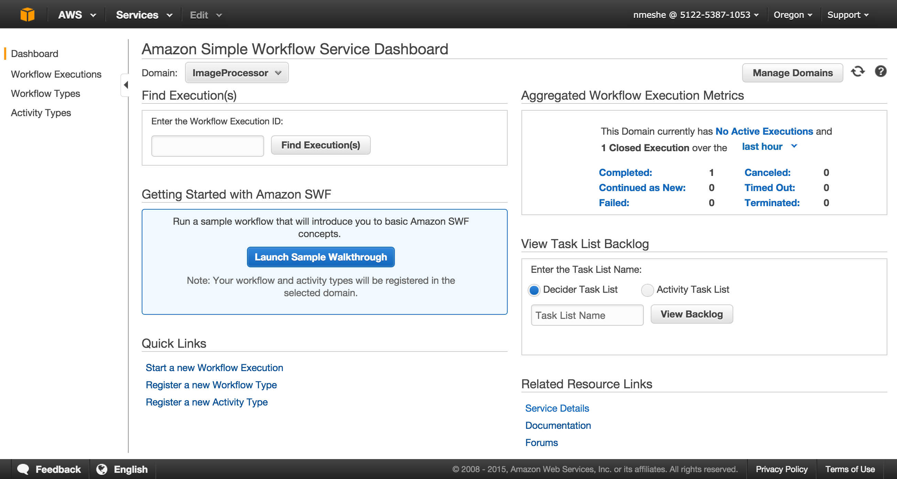
Amazon SWF Dashboard

Slide 39
SWF Dashboard Work
Registering and Managing Domains
Register Workflow Type
Register Activity Type
Start and Manage Workflow Execution
View Pending Tasks
View SWF Metrics

Slide 40
Lifecycle of a Workflow Execution
Images: docs.aws.amazon.com

Slide 41
AWS Flow Framework
a collection of convenience libraries that make it faster and easier to build SWF applications
write simple code and let the framework’s objects and classes handle the details of SWF APIs.
AWS Flow Framework
takes care of creating and executing your application’s steps
keeps track of their progress
lets you define retry rules for when steps fail
quickly create tasks, coordinate them, and express how these tasks depend on each other
run a method in an application on a “remote” computer simply by calling a method in your application logic that is hosted on a separate “local” computer
handle a failure on a remote machine as if it were a local error
gives you easy ways to define retry logic
takes care of the complex back-and-forth needed to execute the remote method and returns its result to the local application
use straightforward syntax to express dependencies between methods with a simple “block and wait for a callback” approach.
open source, developed and managed by AWS
available in Java and Ruby

Slide 42
(Some) Advanced SWF Features
Versioning of Workflows and Activities
Signals
inject information into a running workflow execution
any process can send a signal to an open workflow execution
define the signal name and data to be passed to the signal
program the decider to recognize the signal event
Child Workflows
Markers - record information in the workflow history
Tags
associate tags with workflow executions
query for workflow executions based on these tags
filter the listing of the executions
a free-form string and may be up to 256 characters in length
Integration with AWS CloudTrail
captures API calls made by or on behalf of Amazon SWF
delivers the log files to an Amazon S3 bucket
Metrics for CloudWatch

Slide 43
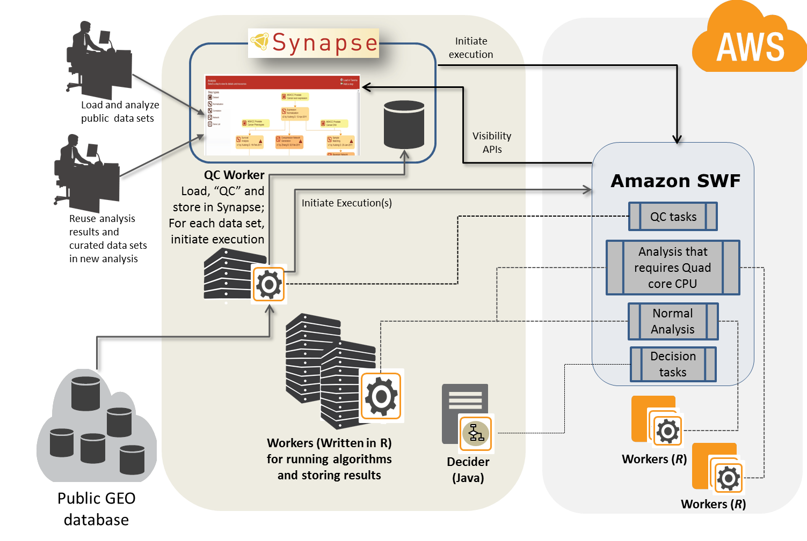
AWS Case Study: Sage Bionetworks

Slide 44
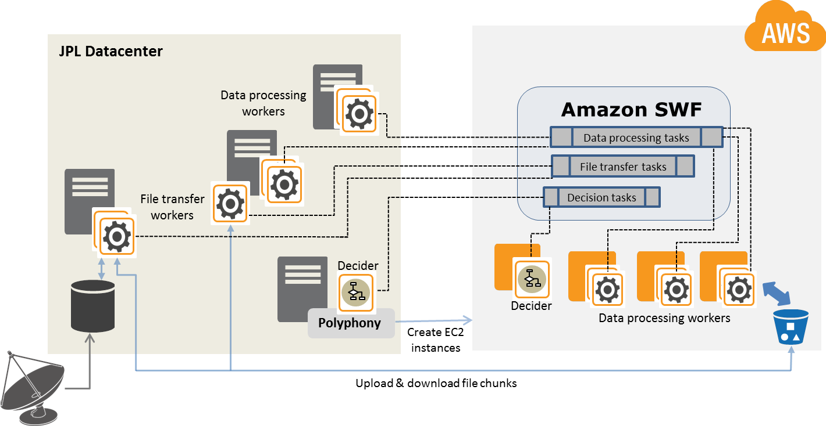
AWS Case Study: NASA JPL

Slide 45
Did Nick earlier say he had a bias? :-)
(caveat - created by owner of first column)
Features | AGS | AWS Data Pipeline | AWS Simple Workflow (SWF) | Apache Oozie | airbnb's Chronos | LinkedIn's Azkaban | Cron
Human Workflow Support | N | N | N | N | N | N | N
Time Scheduling | Y | Y | N | Y | Y | Y | Y
File Arrival Detection | Y | Y | N | Y | N | N | N
Execution Resource Scheduling | Y | N | N | N | N | N | N
Local Resource Scheduling | Y | N | N | N | N | N | N
Fair-Queue Scheduling | Y | Y | Y | N | N | N | N
Supports multiple "agent" types | Y | Y | Y | N | N | N | N
Dynamic Node Provisioning | N | Y | N | N | N | N | N
Flow Design UI | Y | Y | N | Y | Y | Y | N
Priority based scheduling | Y | N | N | N | N | N | N
Multi-tenant with shared resources | Y | N | N | N | N | N | N
Built-in Notification System Support | Y | Y | N | Y | Y | Y | N
S3 File Arrival Support | Y | Y | N | N | N | N | N
Workers use a poll model | N | Y | Y | N | N | N | N
Multi-tenant security model | Y | N | N | N | N | N | N
AWS Specific | N | Y | Y | N | N | N | N
Used Internally at Acxiom | Y | N | N | Y | N | N | Y
Extensible Resource Types | Y | Y | Y | N | N | N | N
Extensible Resource Manager Types | Y | N | N | N | N | N | N
Programmatic Events | Y | N | N | N | Y | Y | N
Attached Files | Y | N | N | N | N | N | N
Control File Substitution | Y | N | N | N | N | N | N
Resource Reservation | Y | N | N | N | N | N | N
Scalable, Fault-tolerant | Y | Y | Y | N | Y | N | N
Programmatic Submission | Y | Y | Y | N | Y | Y | N
Job Dependencies | Y | Y | Y | Y | Y | Y | N
Work Flow Engine agnostic job design language | Y | N | N | N | N | N | N
Delegation of resources to other schedulers | Y | N | N | N | N | N | N
Deployable on a desktop | Y | N | N | Y | Y | Y | Y

Slide 46
Resources
Getting started with SWF: http://aws.amazon.com/swf/getting-started/
AWS Flow Framework: http://aws.amazon.com/swf/details/flow/
SWF at re:Invent 2012: https://www.youtube.com/watch?v=HR3XyvHFYEg
AWS SDK For PHP: http://docs.aws.amazon.com/aws-sdk-php/guide/latest/index.html
Example SWF Workflow for PHP: https://github.com/amazonwebservices/aws-sdk-for-php/tree/master/_samples/AmazonSimpleWorkflow/cron
SWF Developer Guide: http://docs.aws.amazon.com/amazonswf/latest/developerguide
SWF Pricing: http://aws.amazon.com/swf/pricing/
AWS re:Invent - October 6th through 9th http://reinvent.awsevents.com
Thank you!

